Slide 1
NativeScript mit Angular 2
You know Angular. Now you know mobile.

Slide 2
Johannes Hoppe
Sebastian Witalec
@JohannesHoppe
@sebawita

Slide 3
Notes:
For the past 9 months (from May 2105) we’ve been working directly with the Angular team to bring Angular 2 and NativeScript together…
We are doing this to provide the same experience of building mobile apps as it is for web apps.
And thus allowing Angular 2 developers to reuse their skills.

Slide 4
Tobias Bosch
Hristo Deshev
Notes:
So…Every Tuesday starting from May 2015:
the lead developers from the Angular Team [picture of Tobias Bosch]
and Telerik Team [picture of Hristo Deshev]
met using Google Hangouts to plan… (next slide)

Slide 5
Wir versuchen, die Weltherrschaft an uns zu reißen.
Notes:
Mobile App World Domination

Slide 6
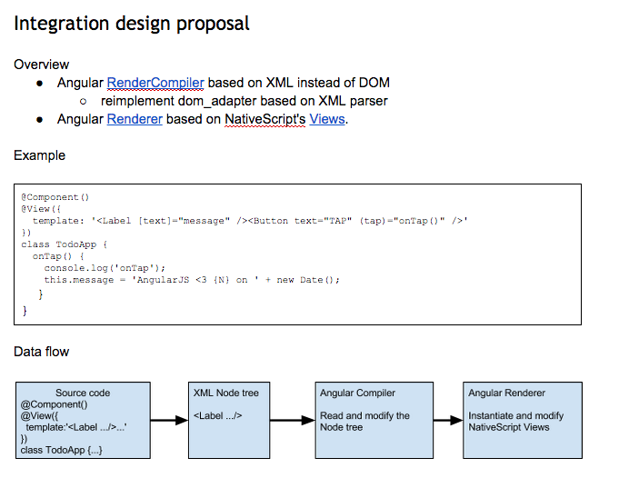
Der finstere Plan auf Google Docs
Notes:
From the very beginning the idea was to take advantage of Angular’s Platform Agnostic architecture
and expand it by adding NativeScript specific components.

Slide 7
Angular 2 mit NativeScript
HTML
Parse5
Compiler
Proto
Views
NativeScript Renderer
Native
Visual Tree
Markup
Dom Adapter
Compiler
Proto Views
Renderer
Visual Tree
Plattformunabhängig
Plattformspezifisch
Notes:
(1)We decided to use HTML as the Markup language, which gave us an opportunity to
(2) use Parse5 as the DomAdapter.
(3) + (4) Because of the way Angular is designed we didn’t have to do anything to the Compiler or the compiled Proto Views (templates)
(5) The real work was in implementing our own Renderer, which generates a Native Visual Tree and is capable of propagating property changes and events between ProtoViews and Native Visual Tree… both ways.

Slide 8
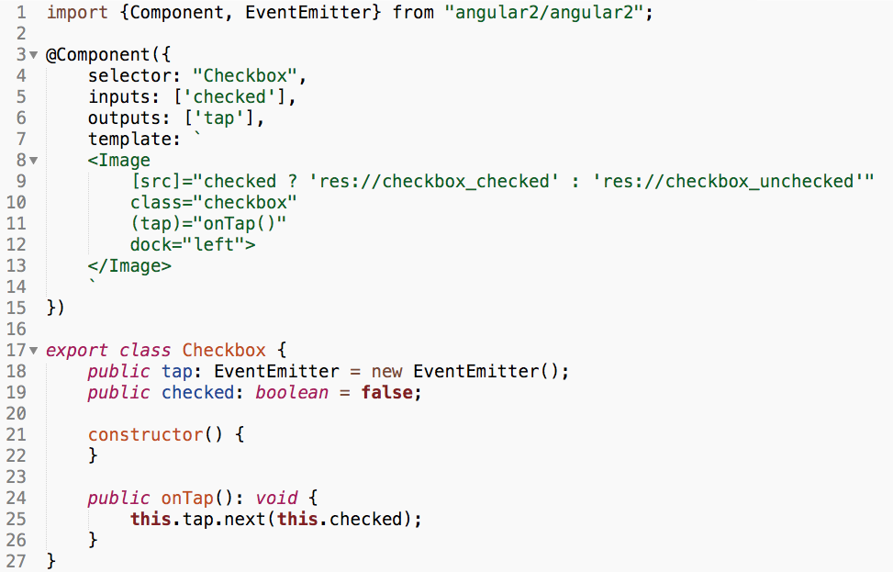
Beispiel: Checkbox mit Angular 2
Component
Class
Notes:
All this means that you can create Angular 2 Modules for NativeScript.
And as expected your component will be made of:
a Component definition – where we define the selector, properties and events
Then we define the View
And finaly complete it with a class definition that contains the javascript that controls the module
But don’t worry we will show you this component in action shortly.
…
So what is NativeScript?

Slide 9
NativeScript ist…
ein Open Source Framework um echte native mobile Apps mit JavaScript zu entwicklen. Nutzen Sie Ihre bestehendes Wissen zu TypeScript, Angular und CSS und Sie erhalten eine native UI und native Performance auf iOS und Android.

Slide 12
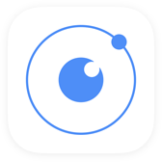
!=
No DOM
!=
No cross compilation
!=
Direct access to native APIs in JS
Notes:
{N} vs PhoneGap and Ionic
{N} vs Xamarin
{N} vs React Native and Appcelerator (Titanium) – check it!!!

Slide 13
Why NativeScript?
Skills reuse
JavaScript and CSS
Angular2
Code reuse
npm modules, 3rd-party iOS and Android libraries
Easily use native APIs
No wrappers to access native APIs
Use native UI elements
Open source!

Slide 14
Warum {N} ?

Slide 15
1
Attraktive, animierte, “kompromisslose” native Oberflächen
(mit einheitlichem UI-Code)
Tipp:
“Examples NativeScript”
im iOS App Store oder in Google Play ausprobieren

Slide 16
2
Code wiederverwenden,
Wissen wiederverwenden
Video credit: Nathan Walker, {N} community member
Notes:
Npm, CocoaPods, Android Arsenal

Slide 17
3
Exzellenter Angular- und TypeScript Support
+
=

Slide 18
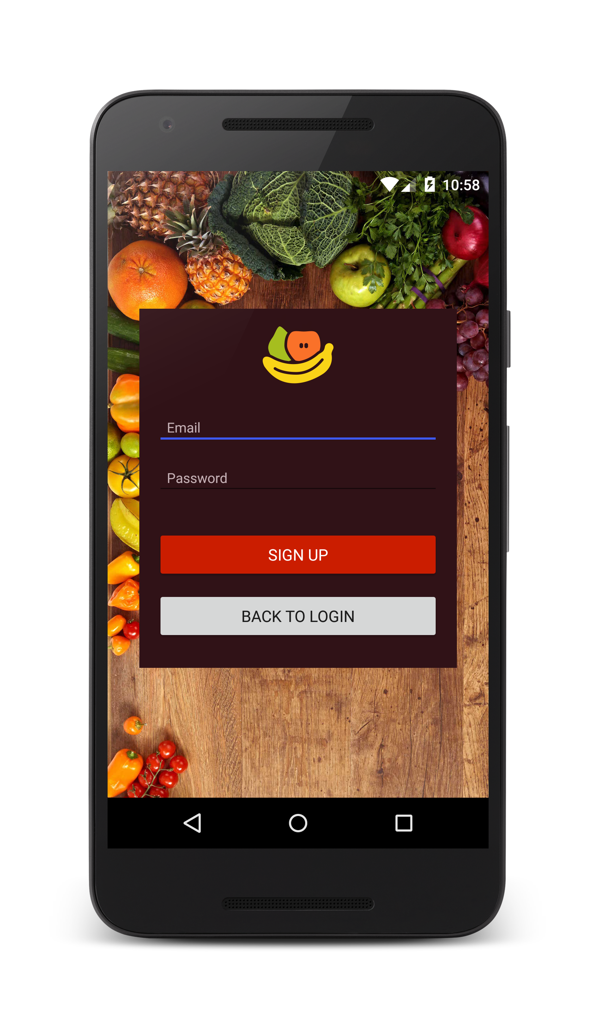
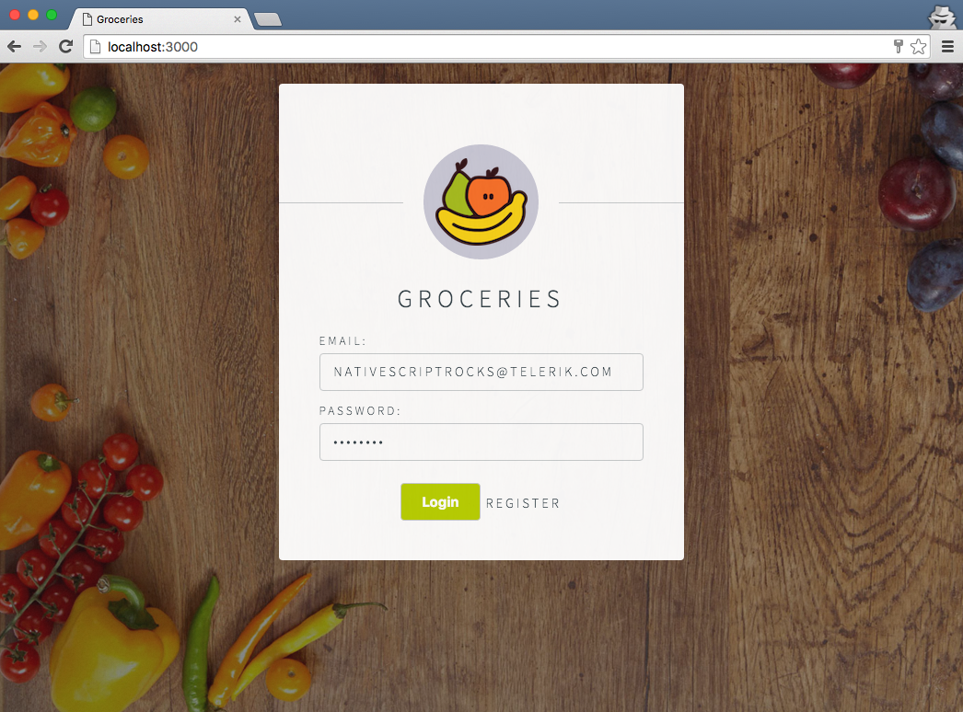
Android
iOS
Web
Notes:
Jen

Slide 19
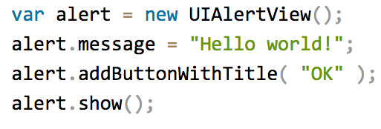
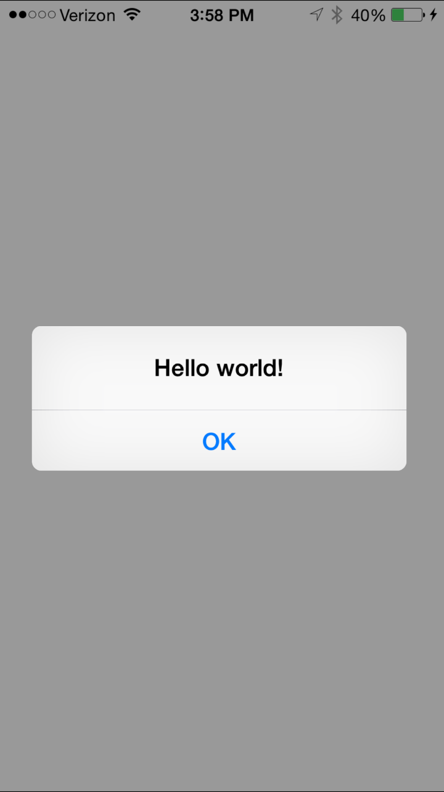
4
100% direkter Zugriff auf Android und iOS APIs
Notes:
Npm, CocoaPods, Android Arsenal

Slide 20
Läuft in der V8 JavaScript VM (von Chrome)
Läuft in der JavaScriptCore VM (von WebKit)
Details: http://bit.ly/how-nativescript-works

Slide 21
Wie
?
funktioniert das

Slide 22
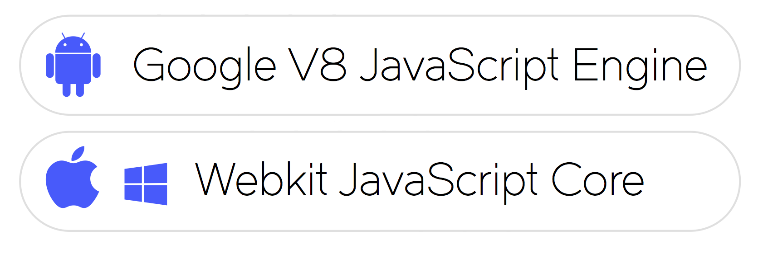
Native APIs aufrufen
Notes:
This is going to be like trying to explain a magic trick, so I hope it won’t take the magic out of it.
NativeScript is not just a set of libraries, but more of a Runtime that enables you to call native APIs: for Android, iOS and Windows Universal
It uses a pre-packaged JavaScript Virtual Machine. To be precise:
•For Android it is – Google’s v8 JavaScript Engine,
•For iOS and Windows Phone it is – WebKit’s JavaScriptCore

Slide 23
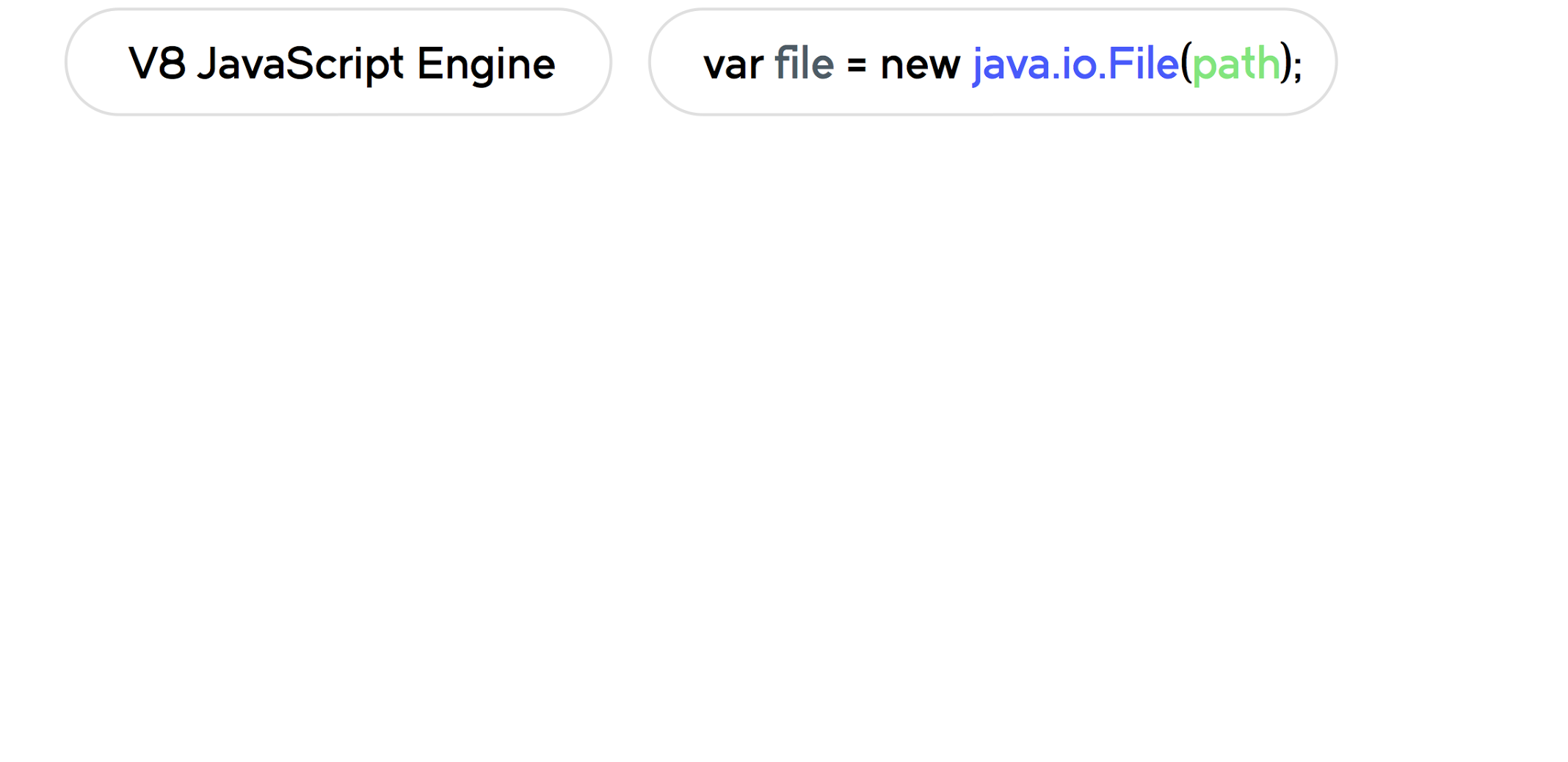
Native APIs aufrufen
Notes:
var file = new java.io.File(path);
which calls Android API to create a file object.
The JavaScript Virtual Machine or in this case Google’s v8 JavaScript Engine, evaluates the code.

Slide 24
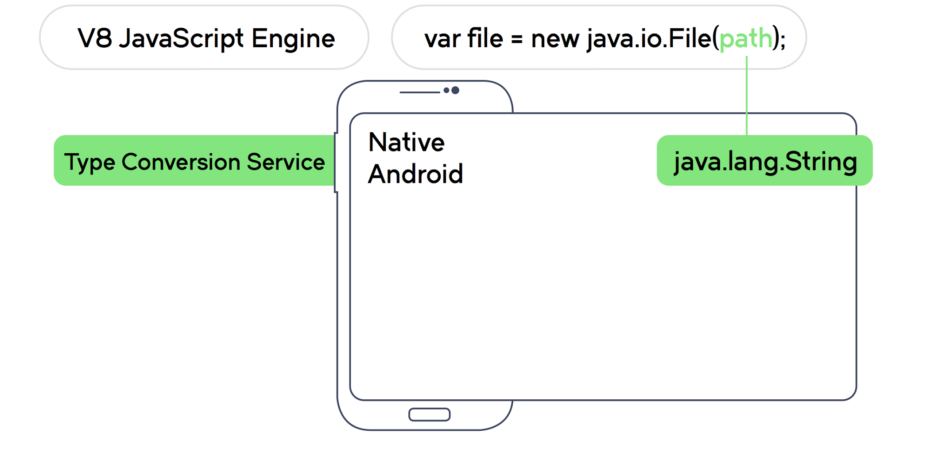
Native APIs aufrufen
Notes:
The Type Conversion Service converts the path value, from the JavaScript String to the native Java String object.

Slide 25
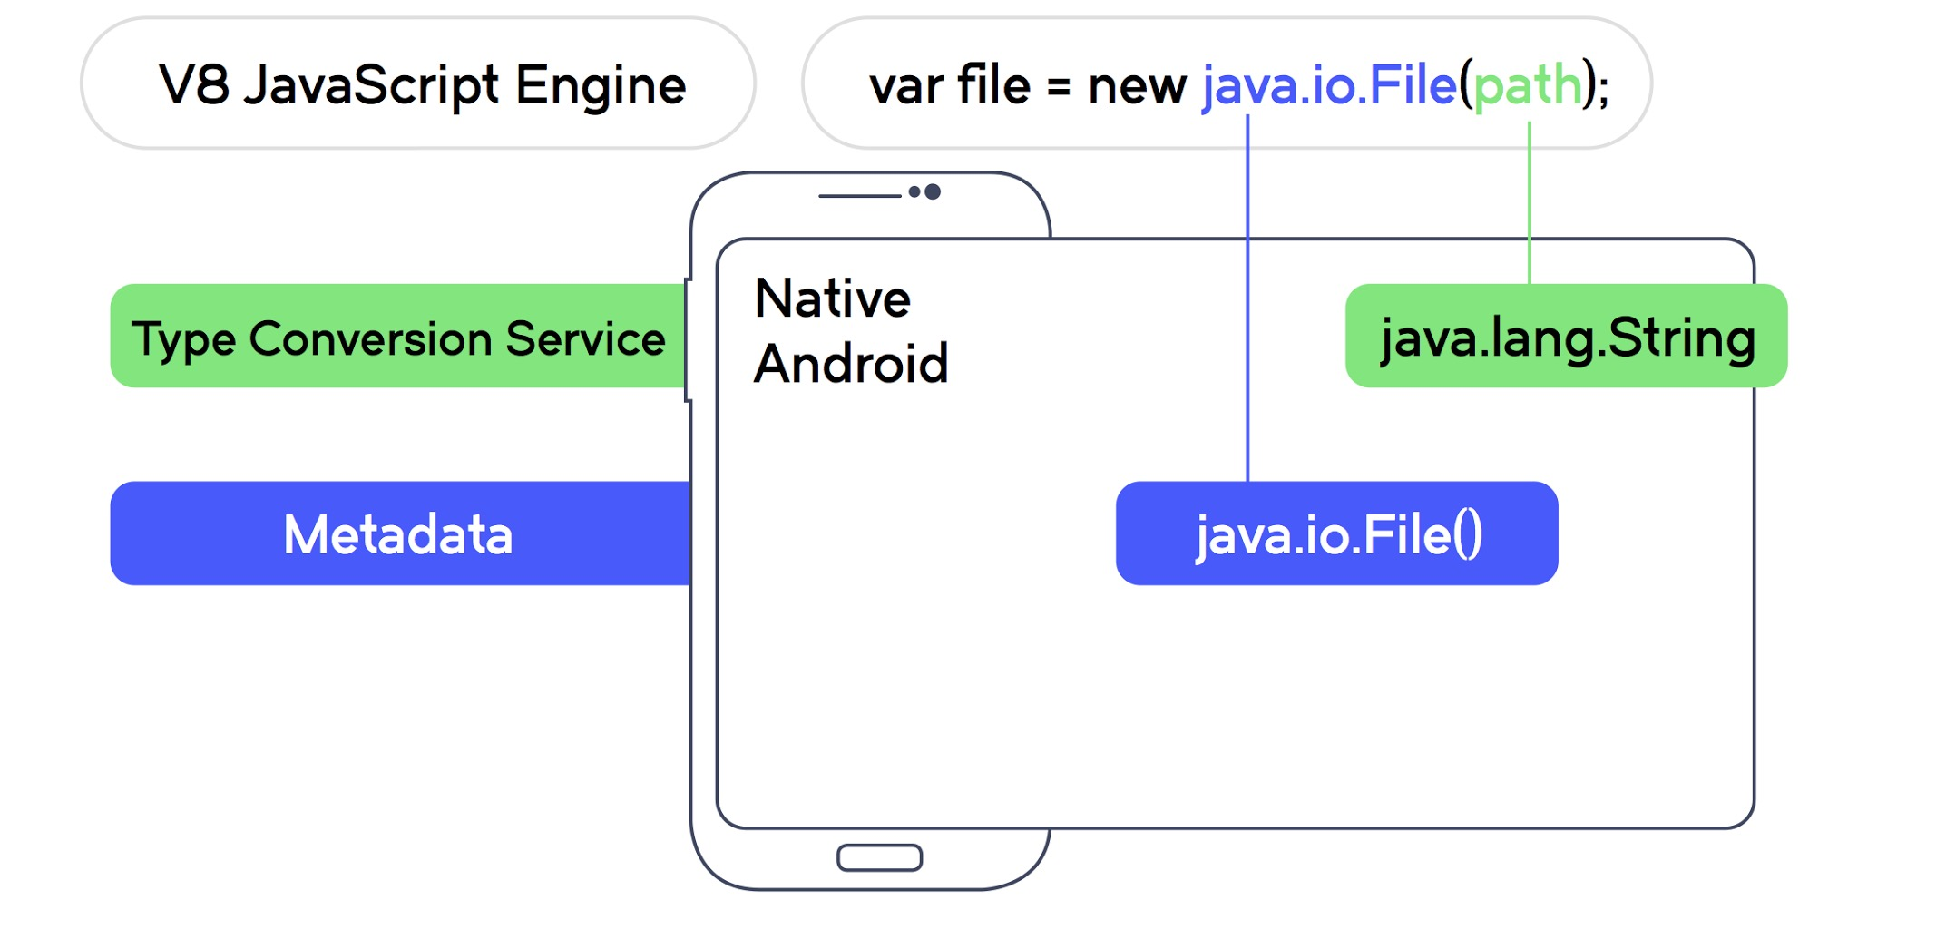
Native APIs aufrufen
Notes:
Metadata will lookup the Android API and determine the corresponding native method to call
and as a result finding the native constructor for the File class.

Slide 26
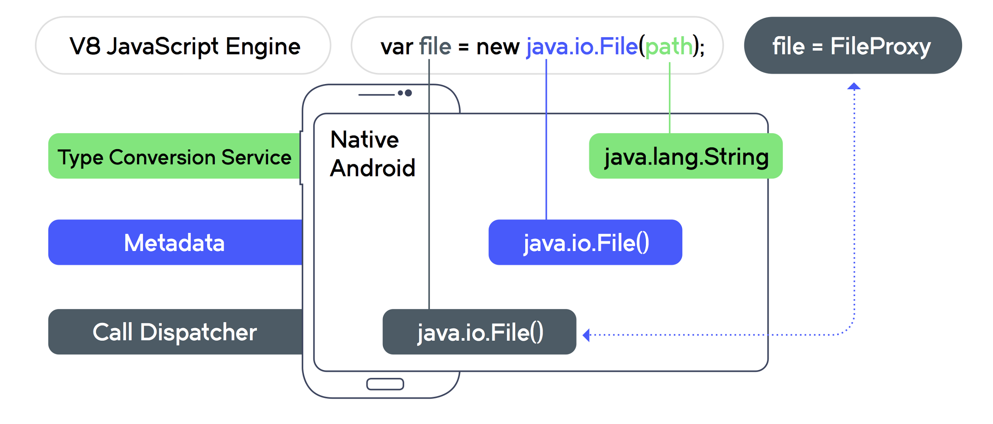
Calling Android API
Notes:
The call dispatcher executes the call with a dual result:
•On the Android Side: we get a new instance of the native File class
•On the NativeScript Side: we get a custom JavaScript Object serving as a proxy to the native Android’s object
When a method is called on this proxy it is delegated to the underlying native object.
<Before the next slide>
This is the foundation of the NativeScript framework.
The next logical step was to create a platform agnostic abstraction layer.
It is really great that you can access native APIs straight form JavaScript.
But I can hear you think. … this still doesn’t solve the problem of me having to learn all those Platform APIs.
But this is just the foundation of the NativeScript framework.

Slide 27
Metadata Generating Process
Null Wartezeit bei der Unterstützung neuer APIs!
M
G
P
≙
Notes:
We don’t have a bunch of people who build the API translations for each platform.
But instead we have the {N} Metadata generating processes – the way it works, if you point it at Android SDK it will build the representation of everything in there. All functions and types. And the same thing happens for iOS as well.
Metadata gets rebuilt every time you build the app. And to make it better, if you add a 3rd party Native plugin/library, the Metadata generating process will also include the additional metadata.
So because of that mechanism {N} provides Day Zero support. So when a new version of a platform comes out, all you have to do is rebuild your app against that version of the platform. For instance we already support Android M, which was announced at Google io. Without us having to make any changes to the bridge.

Slide 28
Moment: Doppelter Code??
Stressed businessman © Selecstock – Fotolia.com

Slide 29
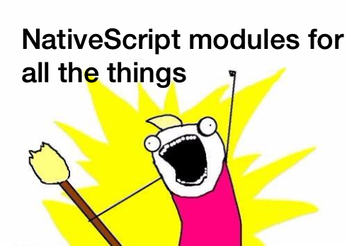

Slide 30
NativeScript modules
Code
Modules
Platform API
Notes:
NativeScript comes equipped with modules that provide cross-platform functionality.
There are dozens of them and they’re easy to write yourself.
NativeScript modules follow Node module’s conventions (CommonJS).

Slide 31
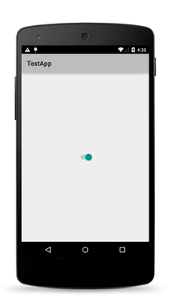
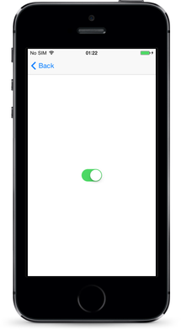
Eine Syntax für alles

Slide 32
Beispiel: NativeScript Datei-Modul

Slide 33
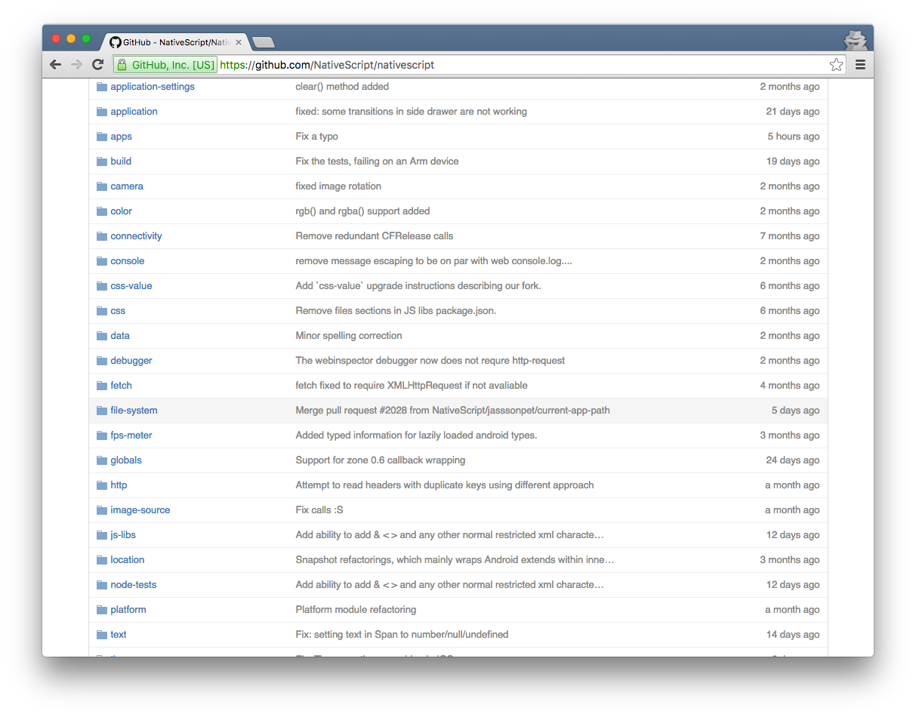
Viele, viele, viele weitere NS-Module

Slide 34
Beispiel: HTTP

Slide 35
Abstraktionsschicht
Abstraktions- schicht
XMLHttpRequest
<NS Module>
Implement-ierung
Native
iOS call
Native Android call
Ziel
iOS App
Android App
Notes:
Now let’s look at the bigger

Slide 36
Abstraktionsschicht
Abstraktions- schicht
HTTP
<Angular Component>
XMLHttpRequest
<NS Module>
XMLHttpRequest
<Browser>
Implement-ierung
Native
iOS call
Native Android call
Ajax call
Ziel
iOS App
Android App
Web App
Notes:
Now let’s look at the bigger

Slide 37
Angular Template-Syntax
Property-Binding: | [property]
Event-Binding: | (event)
Element-Referenzen: | #idhandler
Bedingungen: | *ngIf="expression"
Schleifen: | *ngFor="expression"
Styling: | [class.nameOfClass]="expression"

Slide 38
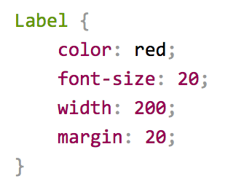
CSS*

Slide 39
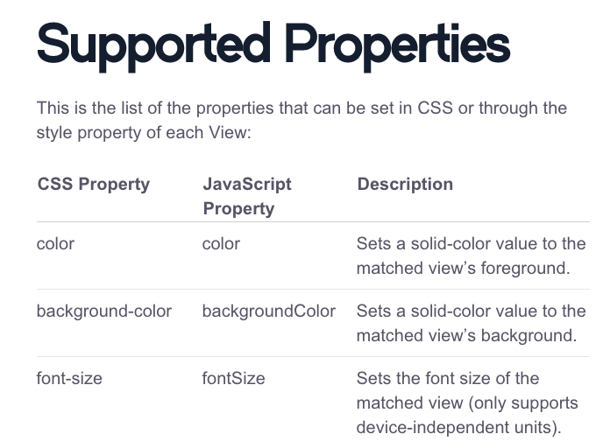
*
http://docs.nativescript.org/styling#supported-properties

Slide 40
Einen Unterschied gibt es
Web UI != Mobile UI
Notes:
This might be obvious

Slide 41
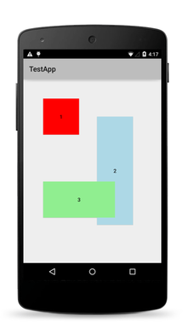
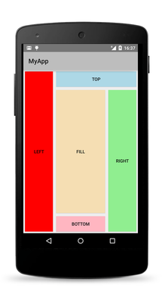
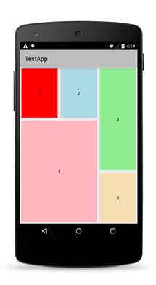
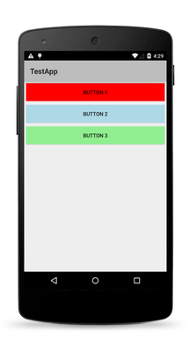
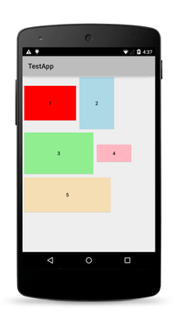
Native Layouts
Absolute
Dock
Grid
Stack
Wrap

Slide 42
DEMO

Slide 43
Early prototypes
“Core” engineering
Public launch
Adoption ramp-up
Mass adoption
2013
2014
2015
2016
2017
Projekt-Timeline

Slide 44
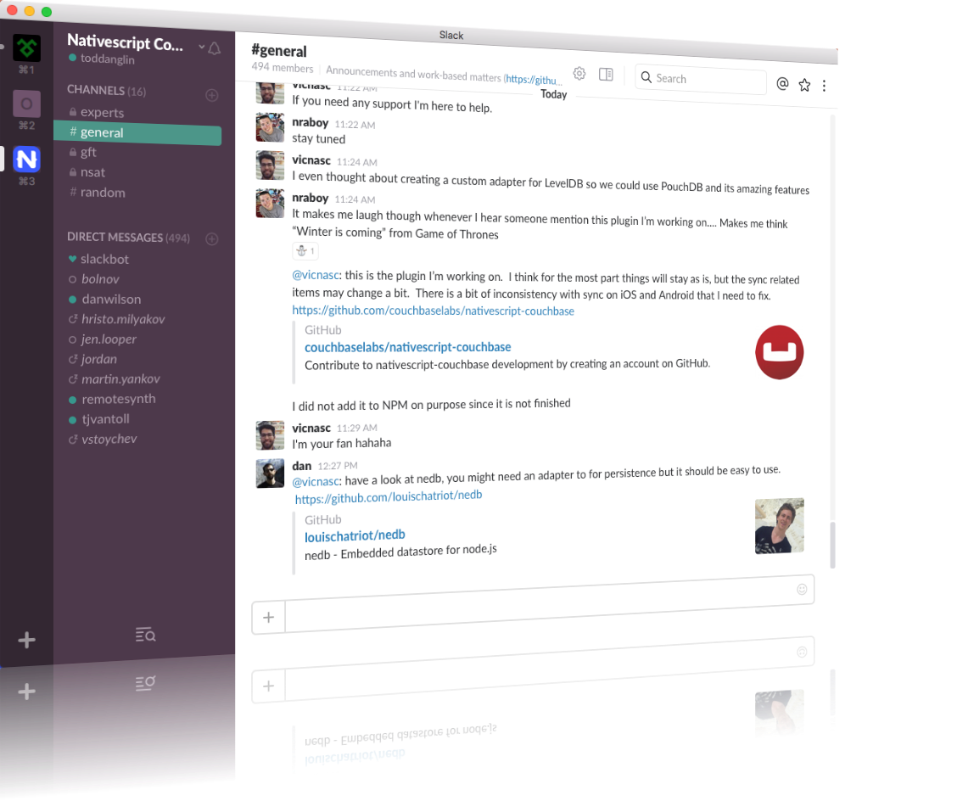
NativeScript-Community auf Slack
bit.ly/nativescript-slack

Slide 45
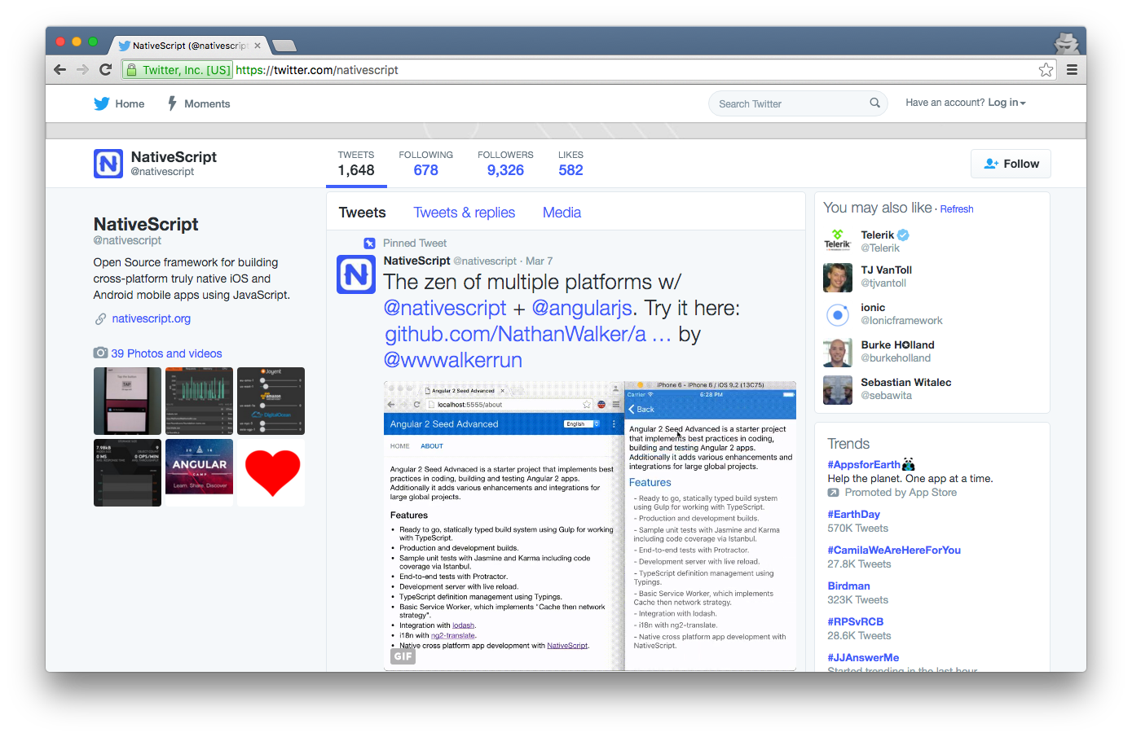
https://twitter.com/nativescript

Slide 46
Q & A

